Slide 1
Sustainability Accounting Standards Board (SASB)
Metrio IT Platform
Energy and GHG Focus

Slide 2
Purpose of the Meeting
Purpose: Provide an overview of the SASB requirements that Celanese will be reporting against beginning in 2021, using CY2020 data.
Review requirements
Gaps from historical process
User instructions
Roles and Responsibilities
Topics will include energy and GHG emissions
Total energy consumed, purchased and self-generated
Scope 1 GHG emissions, gross and net
Scope 2 GHG emissions, gross and net

Slide 3
The ESG Process
1
Materiality Assessment Completed Comparative data collected from SASB, GRI, Rating Services, ACC, and Cefic Data reviewed and materiality topics agreed upon by the ESG Council
Expert Committees Formed 10 committees formed based upon the Celanese assessment results Committee members included Celanese subject matter experts from through-out the organization
Two-Month Committee Deep-Dives Completed Committees analyzed research materials provided, benchmarked against peer disclosures and reports Each committee presented their analyses to the ESG Council for Council feedback Committees subsequently synthesized feedback into a final report-out of their recommendations
Collect Data aligned with SEC, SASB, ACC, Cefic, and rating agencies expectations Implement new environmental data tracking system (Metrio) at manufacturing sites Assess/audit results, establish baselines, and set targets where recommended Continue making incremental updates and updating disclosures of new developments to drive improvement in rating service scores
2
3
4
Completed
Next Steps
3

Slide 4
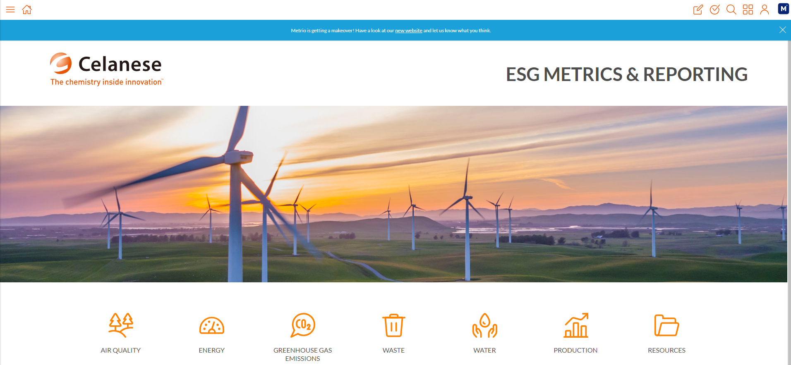
Metrics - New Standard, New Tool
What: Celanese committed to reporting ESG metrics against a global standard
Drivers: Investors, Customers, Regulators, Peer Companies
When: Celanese will disclose ESG data in 2021 based on CY2020 data
Why: Based on multiple stakeholder reviews, Celanese selected SASB standard which will enable stakeholders to track and compare sustainability performance with similar companies. Also will align with ACC sustainability requirements
How: Celanese identified and is moving to new on-line environmental metric reporting tool using Metrio - a SASB-licensed supplier - to replace the current Dakota tool
Timing: Preparation work on-going, Go-Live and Data Entry planned for January 2021
Notes:
Phase 1 and 2: 2005 – 2012
Phase 3: 2013 – 2020
Phase 4: 2021 - 2030

Slide 5
Metrio Upgrades Time Line
Metrio System Upgrades
Additional licenses to eliminate lack of access to system
Improvement of system speed
Supporting documentation & validation of data integrated into work process
Simplified reporting / use of technology
Excel upload
Links to SAP, Pi, other (future projects) to pull data
Customized dashboards for site, corporate and executive requirements
Expectations
Reporting frequency mostly monthly
CE site roles identified to enter, validate and approve data
ME / TS role / Environmental Engineer for Data entry
TL / Env Program Owner / UL for validation & approval
Kickoff and account configuration – Aug 2020
SASB Gap analysis – Sept 2020
Creation of metrics system – Oct 2020
Dakota Metrics Cut-off – October 31
Enter all energy and production data through Q3 *
Enter all other monthly data; otherwise required to be entered into Metrio beginning Jan 2021 *
Data visualization / Dashboard development – Nov 2020
User acceptance testing – Nov 2020*
Metrio User Training → Jan 2021*
Metrio Import of Dakota Data → Dec 2020 / Jan 2021*
Metrio Go-Live → Jan 2021*
Completion and validation of 2020 data → Jan 2021 *
System adjustments, data complete → Jan–April 5, 2021 *
Sustainability Report → Q2- 2021 *
* Site support needed

Slide 6
Expectations for Validators / Approver
Monthly review of data entry
On time, Complete
Trending, Outliers, Changes
Supporting documentation matches data entry
More than validation that the data was entered
Cadence of auditing data collection management system
Change Management (MOC) for changes to data collection or processes
2X Annual management systems review
Documentation of Work Process
Tier 3 or 4 documentation of work process
Training of New Employees
MOOC process
Ensure work process drift and error prevention

Slide 7
Energy Requirement
RT-CH-130a.1. (1) Total energy consumed, (2) percentage grid electricity, (3) percentage renewable, (4) total self-generated energy
Disclose total amount of energy it consumed as an aggregate figure, in gigajoules (GJ).
Scope of energy consumption includes energy from all sources, including energy purchased and energy produced by the entity itself (self-generated).
Examples, direct fuel usage, purchased electricity, and heating, cooling, and steam energy
Scope of energy consumption includes only energy directly consumed by the entity
Calculating energy consumption from fuels and biofuels → must use higher heating values (HHV / GCV)
Disclose % energy it consumed that was supplied from grid electricity
Disclose % energy it consumed that is renewable energy
Renewable energy = energy from sources that are replenished at a rate > rate of depletion, such as geothermal, wind, solar, hydro, and biomass
Renewable energy includes renewable fuels the entity consumed, renewable energy the entity directly produced, and renewable energy the entity purchased / If purchased via renewable PPA that explicitly includes renewable energy certificates (RECs) or Guarantees of Origin (GOs), a Green‐e Energy Certified utility or supplier program, or other green power products that explicitly include RECs or GOs, or for which Green‐e Energy Certified RECs are paired with grid electricity
Disclose amount self-generated energy by the entity as an aggregate figure, in gigajoules (GJ)

Slide 8
Energy Requirement
Additional disclosures
Discuss efforts to reduce energy consumption and/or improve energy efficiency throughout the manufacturing and production processes
Encouraged to disclose the aggregate energy savings (in gigajoules) achieved through such efforts and processes

Slide 9
GHG Requirements
RT-CH-110a.1. Gross global Scope 1 emissions, percentage covered under emissions-limiting regulations
Disclose its gross global Scope 1 greenhouse gas (GHG) emissions to the atmosphere of the seven GHGs covered under the Kyoto Protocol—carbon dioxide (CO2), methane (CH4), nitrous oxide (N2O), hydrofluorocarbons (HFCs), perfluorocarbons (PFCs), sulfur hexafluoride (SF6), and nitrogen trifluoride (NF3).
GHGs consolidated and disclosed in metric tons of carbon dioxide equivalents (CO2-e) using GWP values is the Intergovernmental Panel on Climate Change (IPCC) Fifth Assessment Report (2014)
Gross emissions are GHGs emitted into the atmosphere before accounting for offsets, credits, or other similar mechanisms that have reduced or compensated for emissions
Scope 1 emissions are defined and shall be calculated according to the methodology contained in the GHG Protocol. Note: We are reporting gross scope 1 emissions for Celanese owned and/or operated assets (operational control approach)
Disclose the % of gross global Scope 1 GHG emissions covered under an emissions-limiting regulation or program
Discuss changes in emissions from the previous reporting period. For example: emissions reductions, divestment, acquisition, mergers, changes in output, and/or changes in calculation methodology.

Slide 10
GHG Requirements
RT-CH-110a.2. Discussion of long-term and short-term strategy or plan to manage Scope 1 emissions, emissions reduction targets, and an analysis of performance against those targets
Discuss its long-term and short-term strategy or plan to manage its Scope 1 greenhouse gas (GHG) emissions.
Discuss its emission reduction target(s) and analyze its performance against the target(s)
Discuss the activities and investments required to achieve the plans and/or targets, and any risks or limiting factors that might affect achievement of the plans and/or targets
Discuss the scope of its strategies, plans, and/or reduction targets, such as how they relate to different business units, geographies, or emissions sources
Discuss whether its strategies, plans, and/or reduction targets are related to, or associated with, emissions limiting and/or emissions reporting-based programs or regulations
Disclosure of strategies, plans, and/or reduction targets shall be limited to activities that were ongoing (active) or reached completion during the reporting period.

Slide 11
SASB Data Requirements and CE Gaps Identified
Large
Category
Scope 1
Category
Scope 2
Natural gas combustion
Steam sold (BTU)
Cogen system (natural gas)
Non-renewable self-generated power
Renewable self-generated power
Purchased steam/heat
Fuel for Steam
Purchased non-renewable electricity
Purchased renewable electricity
Electricity
Cogen
Cogen steam sold
Cogen electrical power sold
CO2 Vents
CO2 vents --> other direct CO2e sources
Steam
Magnitude of emissions
Cooling/Chilled water purchased
Vent Gas Abatement
Vent gas abated/controlled
Cooling
Water Treatment
Aerobic wastewater treatment
Air
Compressed air purchased
Landfill Emissions
Celanese landfill emissions (CO2e)
CE 2019 actual CO2e (indirect): ~986KT
HazWaste Combustion
Hazardous waste incineration
Non-HW Combustion
Non- HW combusted onsite
Process Emissions
Fugitive emissions/ leaks/ process emissions
Fuel-Misc.
Miscellaneous fuels
Refrigerants
Refrigerants
Key CE gaps identified
Small
CE 2019 actual CO2e (direct): ~1,935KT
In-line
In process to quantify key gaps and develop strategies to meet SASB requirements

Slide 12
Energy

Slide 13
Energy - Purchased Energy, excluding mobile and steam or electricity combustion sources
User Instructions:
Purchased Fuels: Enter the gross fuel measured volume or heat content associated with purchased fuels for the operation of stationary plant equipment. Plant equipment under this category excludes production of steam which is captured separately.
Examples include fuel usage for: flare pilots, furnaces, incinerators, thermal oxidizers, emergency generators, diesel equipment.
Fuel options include: coal, diesel/distillate fuel oil, LPG, Natural Gas, Propane, Residual Fuel Oil
Gross GHG emissions will be quantified using appropriate emission factors and GWPs.
Purchased utilities: Enter the measured gross amount of energy or volume associated with purchased utilities.
Examples include: purchased electricity (renewable and non-renewable) or steam, compressed air, plant nitrogen, and other utilities provided by other companies.
Purchased utilities include: boiler feed water, chilled and cold water, cold ammonia, compressed air, cooling brine, cooling water, electricity, instrument air, nitrogen, river water, and steam (by fuel type)
Gross GHG emissions will be quantified using appropriate emission factors and GWPs.
Sites encouraged to link upload template to process to existing data process
Data Entry Role:
Frequency – monthly data input
Site – Process – By unit or area
Energy source (unit) – Unit of Measure
Quantity – amount (numerical)
Cost – $USD
Notes if needed
Attachments: Required to upload Evidence to support energy input

Slide 14
Energy - Fuel for steam and electricity generation
User Instructions:
Purchased Fuels: Enter the measured gross fuel volume purchased, volume of recovered process streams (recovered methane, ethylene, tail gas from process), and vent gas emissions combusted to produce steam and/or electricity on your site.
Fuel options include: coal, diesel/distillate fuel oil, LPG, Natural Gas, Propane, Residual Fuel Oil, hydrogen product, raw hydrogen, recovered ethylene and methane, and tailgas
Gross GHG emissions will be quantified using appropriate emission factors and GWPs.
Enter volume of steam and electricity sold.
If steam and electricity are produced and sold to a 3rd party, net GHG emissions will be quantified based on volume of steam sold to the 3rd party.
Sites encouraged to link upload template to process to existing data process
Data Entry Role:
Frequency – monthly data input
Site – Process – By unit or area
Fuel combusted (unit) – selected all that apply, monthly
Quantity – amount (numerical)
Cost – $USD
Steam generated/sold – enter total amount of steam generated and sold
Electricity generated/sold – enter total amount of electricity generated and sold
Notes if needed
Attachments: Required to upload Evidence to support energy input

Slide 15
Energy - Purchased Energy, mobile combustion
User Instructions:
Purchased Fuels: Enter the measured or estimated fuel volume purchased for use in off-road vehicles (e.g., fork trucks, cranes, and lifts) and onsite passenger vehicles (trucks and cars)
Fuel options include: offroad vehicle diesel, gasoline, propane / passenger vehicle diesel and gasoline
GHG emissions will be quantified using appropriate emission factors and GWPs
Please upload documented basis (how amount/volume is determined (flow meter, calculation, invoice)) and record.
Sites encouraged to link upload template to process to existing data process
Data Entry Role:
Frequency – monthly data input
Site – Process – By unit or area
Vehicle type and fuel – passenger or offroad vehicle
Unit – Liters or gallons
Quantity – amount (numerical)
Cost – $USD
Notes if needed
Attachments: Required to upload Evidence to support energy input

Slide 16
Self-generated electricity (excl. from fuels)
DO NOT ENTER ELECTRICITY GENERATED BY BURNING FUELS (included in the "Fuel for steam and electricity generation" form).
Self-generated electricity: enter the amount of self-generated renewable and non-renewable electricity generated that is not included in the "Fuel for steam and electricity generation" form.
If electricity is sold to the grid, or to 3rd parties, enter the amount of electricity sold to calculate the net GHG emissions for the facility.
Sites encouraged to link upload template to process to existing data process
Data Entry Role:
Frequency – monthly data input
Site – Process – By unit or area
Electricity generated – enter total amount of electricity generated
Electricity sold – enter total amount of electricity sold
Notes if needed
Attachments: Required to upload Evidence to support energy input

Slide 17
Renewable power purchase agreements
Renewable Power Purchase Agreement: The scope of renewable energy includes renewable fuel the entity consumed, renewable energy the entity directly produced, and renewable energy the entity purchased, if purchased through a renewable power purchase agreement (PPA) that explicitly includes renewable energy certificates (RECs) or Guarantees of Origin (GOs), a Green‐e Energy Certified utility or supplier program, or other green power products that explicitly include RECs or GOs, or for which Green‐e Energy Certified RECs are paired with grid electricity. Enter amount of renewable power recognized through the PPA.
Upload evidence and supporting documentation
Sites encouraged to link upload template to process to existing data process
Data Entry Role:
Frequency – monthly data input
Site – Process – By unit or area
Type renewable power purchase agreement – REC, GO, Other
Quantity – purchased
Notes if needed
Attachments: Required to upload Evidence to support energy input

Slide 18
Energy saved due to efficiency improvements
Please include the number of energy efficiency projects (e.g., energy reduction, heat integration) and source reductions initiatives along with corresponding energy savings in BTUs.
Please refer to the productivity database for more information on site projects for energy. Please contact your site energy coordinator for details on energy projects.
Sites encouraged to link upload template to process to existing data process
Data Entry Role:
Frequency – annual data input
Site – Process – By unit or area
Energy saved – BTUs
Short Description of initiative – provide brief narrative
Notes – additional details (reference to productivity database entry)
Attachments: Required to upload Evidence to support energy input

Slide 19
GHG – Scope 1 and Scope 2

Slide 20
Refrigerant Gas Loss
User Instructions:
For refrigerant emissions, enter the estimated volume or amount of refrigerants, by refrigerant type into the entry log.
Depending on the type of refrigerant emissions, they will either be converted to GHG Scope 1 emissions (Kyoto Protocol) or other GHG emissions (Non-Kyoto Protocol).
If the refrigerant being reported does not exist, please contact Metrio to add them.
Data Entry Role:
Frequency – monthly data input by site
Enter refrigerant type (e.g., HFC-134a)
Quantity – enter kg released or refilled into equipment
Notes if needed
Attachments: Required to upload Evidence to support GHG emissions input

Slide 21
Process Emissions, incl. CO₂ Vents to Atmosphere
User Instructions:
For CO2 Vent Emissions, Fugitive Emissions, Miscellaneous Process Emissions, and Process leaks, enter amount of CO2 and Methane (CH4) emitted from Celanese owned and/or operated equipment and facilities.
Utilize measured flows using instrumentation or estimated emissions for process leaks, process emissions, and CO2 vents.
Regarding fugitive emissions for CO2 and methane, only include monitored or measured values (no estimates required).
Upload documentation and basis for reported values.
Data Entry Role:
Frequency – quarterly data input
Site – by process
Type of emission - select
Fugitive emissions (CO2 or CH4): required if a site measures or monitors equipment as part of a leak detection and repair program. Quantified emissions from measured or monitored components
Process leaks (CO2 or CH4): Leaks or CO2, methane or natural gas. This data should be consistent with OIS reported emissions.
Vents to Atmosphere (CO2): Emissions associated with CO2 vents from Celanese owned and/or operated equipment or facilities
Miscellaneous process emissions (CO2 or CH4): Other miscellaneous CO2 or CH4 emissions from Celanese equipment not captured elsewhere
Quantity – enter MT emitted
Notes if needed
Attachments: Required to upload Evidence to support GHG emissions input

Slide 22
Emissions from Vent Gas Abatement and Control (w/o steam generation)
User Instructions:
This section is for Scope 1 GHG emissions associated with Celanese owned and/or operated onsite air pollution control equipment such as flares, incinerators, thermal oxidizers, catalytic incinerators, and furnaces. Please ensure site activity associated with combustion of waste vent gas is clearly documented.
Sites are requested to enter aggregated process gas emissions controlled/abated by equipment type.
Please note that fuels such as natural gas, LPG, and fuel oil should be entered into the appropriate purchased energy form in the Energy section.
If there is an air control device that combusts vent gases that is missing, please contact Metrio to add.
Users must upload attachments/evidence to support data entered.
Scope 1 GHG emissions will be calculated using the following equation: CO2 emissions = [material combusted] * [carbon content] * [MW CO2] / [MW C]
Data Entry Role:
Frequency – quarterly data input
Site – by process
Source of emissions - select
Flaring
Vent gas incineration/thermal oxidizer
Catalytic incineration
Waste gas combustion in boiler
Furnace
Other
Quantity (MT) abated or controlled
Carbon content – enter as a decimal
Notes if needed
Attachments: Required to upload Evidence to support GHG emissions input

Slide 23
Celanese On-site Waste Incineration
User Instructions:
Enter total waste combusted (hazardous and non-hazardous waste) and aggregated or combined carbon content for waste materials combusted in Celanese owned and/or operated onsite waste incineration units.
Emissions calculations and data inputs MUST be consistent with total waste volumes entered into the onsite waste incineration forms (material combusted or abated (tonnes) must equal combined values for hazardous and non-hazardous waste streams).
Upload attachments/evidence to support data entered
Scope 1 GHG emissions will be calculated using the following equation: CO2 emissions = [material combusted] * [carbon content] * [MW CO2] / [MW C]
Data Entry Role:
Frequency – quarterly data input by site
Quantity (MT) abated or controlled – Sum of Hazardous and Non-Hazardous Waste
Carbon content – enter as a decimal
Notes if needed
Attachments: Required to upload Evidence to support GHG emissions input

Slide 24
Celanese On-site Wastewater Treatment Emissions
User Instructions:
Calculate annual GHG emissions from Celanese aerobic onsite waste water treatment operations by completing and uploading the WWTP Carbon Mass balance Excel File.
As of December 2020, file still under construction
Emissions entered MUST be consistent with calculated emissions from the WWTP Carbon Mass balance Excel File.
Upload WWTP Carbon Mass balance Excel File to support data entered
Data Entry Role:
Frequency – annual data input by site
Quantity (MT) CO2e calculated using WWTP Carbon Mass balance Excel
Emissions entered MUST be consistent with calculated emissions from the WWTP Carbon Mass balance Excel File; entries include:
Influent flow and COD
Effluent flow and COD
Average MW of COD
Biomass production
Notes if needed
Attachments: Required to upload Evidence to support GHG emissions input
Note: For questions and/or support on WWTP calculations, please Dinesh Arora
Template is being finalized and will be made available upon completion

Slide 25
Celanese On-site Landfill Emissions
User Instructions:
Enter GHG emissions from Celanese owned and/or operated landfills calculated using site-specific spreadsheets.
Emissions calculations and data inputs MUST be consistent with total waste volumes entered into the onsite landfill form.
Upload attachments/evidence to support data entered
Data Entry Role:
Frequency – annual data input by site
Quantity (MT) CH4 calculated using site specific calculations; must be consistent with sum of total waste in Celanese onsite landfills from the waste section
Notes if needed
Attachments: Required to upload Evidence to support GHG emissions input

Slide 26
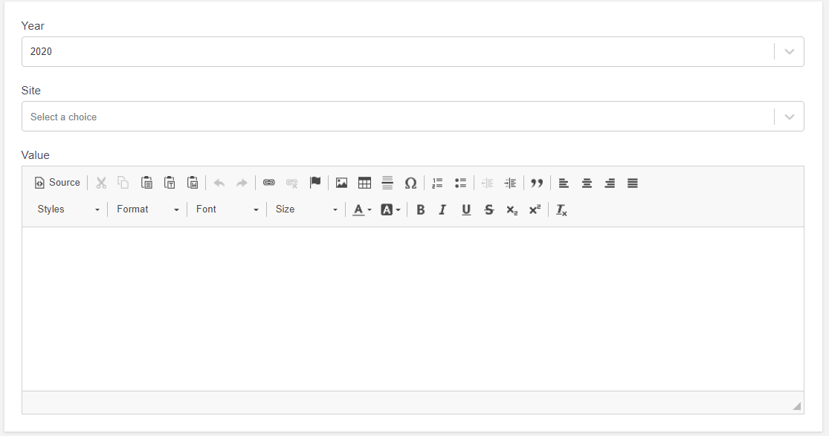
GHG emissions discussion and analysis
Please briefly describe your site’s short & long term strategy to reduce energy consumption and GHG emissions. This could include projects for reducing energy consumption and any additional activity that directly emits Scope1 GHG emissions or indirect emissions of Scope 2 GHG.
As per SASB requirements:
The entity shall discuss its long-term and short-term strategy or plan to manage its Scope 1 greenhouse gas (GHG) emissions.
The entity shall discuss its emission reduction target(s) and analyze its performance against the target(s), including the following, where relevant:
The entity shall discuss the activities and investments required to achieve the plans and/or targets, and any risks or limiting factors that might affect achievement of the plans and/or targets.
The entity shall discuss the scope of its strategies, plans, and/or reduction targets, such as how they relate to different business units, geographies, or emissions sources.
The entity shall discuss whether its strategies, plans, and/or reduction targets are related to, or associated with, emissions limiting and/or emissions reporting-based programs or regulations (e.g., the EU Emissions Trading Scheme, Quebec Cap-and-Trade System, California Cap-and-Trade Program), including regional, national, international, or sectoral programs.
Disclosure of strategies, plans, and/or reduction targets shall be limited to activities that were ongoing (active) or reached completion during the reporting period.
Data Entry Role:
Frequency – annual data input by site
Estimated GHG reduced – scope 1 and scope 2
Short Description of initiative – provide brief narrative

Slide 27
Emission Reduction Initiatives
Please include the number of source reductions initiatives (e.g., energy reduction, heat integration, reduced flaring or waste activities) and source reductions initiatives along with corresponding GHG reductions.
Please contact your site technology leader for details on GHG emission reductions.
Sites encouraged to link upload template to process to existing data process
Data Entry Role:
Frequency – annual data input
Site – Process – By unit or area
Number of reduction projects
Emissions reduced in lbs
Notes – additional details (reference to productivity database entry)
Attachments: Required to upload Evidence to support energy input

Slide 28
GHG Emission Factors
Emission Factors
Purchased fuels (from energy file)
Purchased utilities (from energy file)
Recovered process streams for energy (from energy file)
Purchased mobile fuels (from energy file)
Self-generated electricity
Renewable power purchase agreements
Global Warming Potentials
CO2 = 1
CH4 = 28
N2O = 265
Refrigerant = refrigerant specific, calculated if a known mixture
Emission factors will be reviewed annually for accuracy and consistency

